Slide 1

PROGRAMMING IN PYTHON
LISTS, TUPLES, SETS AND DICTIONARY
Mrs. C.SHYAMALADEVI M.C.A., M.Phil., B.Ed.,
ASSISTANT PROFESSOR,
DEPARTMENT OF COMPUTER SCIENCE,
SHRIMATI INDIRA GANDHI COLLEGE,
TRICHY-2.

Slide 2

• Understand the basic concepts of various collection data types in python such as List, Tuples, sets and Dictionary.
• Work with List, Tuples, sets and Dictionaries using variety of functions.
• Writing Python programs using List, Tuples, sets and Dictionaries.
• Understand the relationship between List, Tuples and Dictionaries.

Slide 3
Introduction to List
A list is a container which holds comma-separated values (items or elements) between square brackets where items or elements need not all have the same type.

Slide 4

Python programming language has four collections of data types such as List, Tuples, Set and Dictionary.
A list in Python is known as a “sequence data type” like strings.
It is an ordered collection of values enclosed within square brackets [ ].

Slide 5

Each value of a list is called as element.
It can be of any type such as numbers, characters, strings and even the nested lists as well.
The elements can be modified or mutable which means the elements can be replaced, added or removed.

Slide 6
Every element rests at some position in the list.
The position of an element is indexed with numbers beginning with zero which is used to locate and access a particular element.

Slide 7

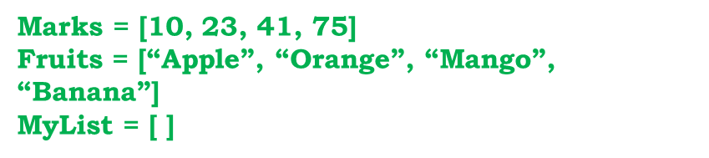
Create a List in Python
A list is simply created by using square bracket.
The elements of list should be specified within square brackets.

Slide 8
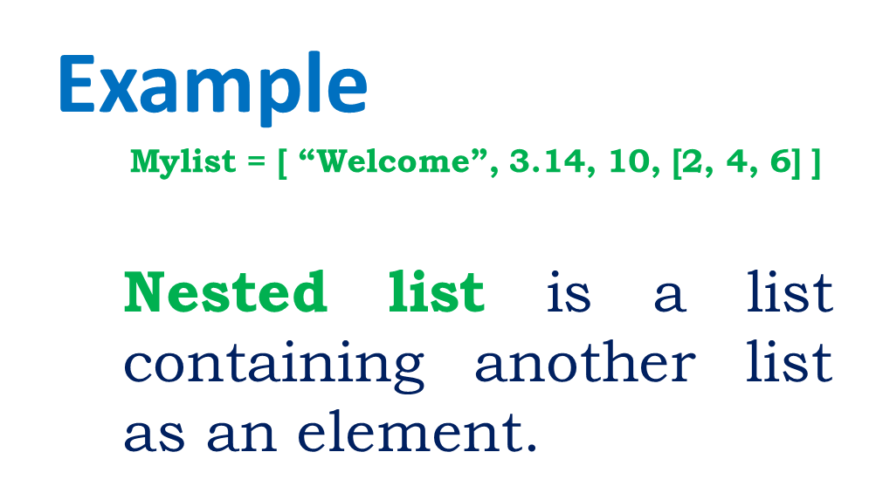
Syntax
Variable = [element-1, element-2, element-3 …… element-n]

Slide 9
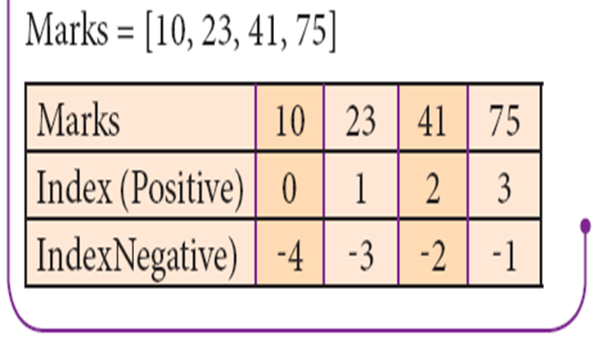
Accessing List elements
Python assigns an automatic index value for each element of a list begins with zero.
Index value can be used to access an element in a list.
In python, index value is an integer number which can be positive or negative.

Slide 10
Positive value of index counts from the beginning of the list
Negative value means counting backward from end of the list (i.e. in reverse order).
To access an element from a list, write the name of the list, followed by the index of the element enclosed within square brackets.

Slide 11
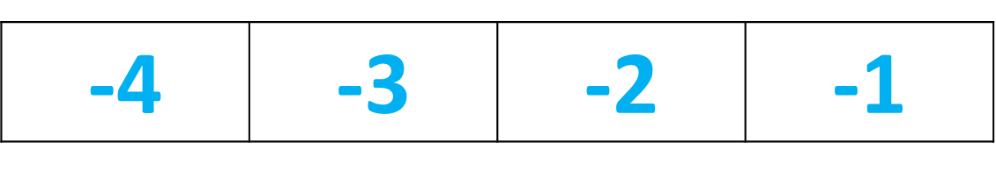
Syntax
List_Variable = [E1, E2, E3 …… En]
print (List_Variable[index of a element])
0 | 1 | 2 | 3
10 | 23 | 41 | 75

Slide 12
Example
Marks = [10, 23, 41, 75]
print (Marks[0])
print (Marks[1])
print (Marks[2])
print (Marks[3])
Output
10
23
41
75

Slide 13
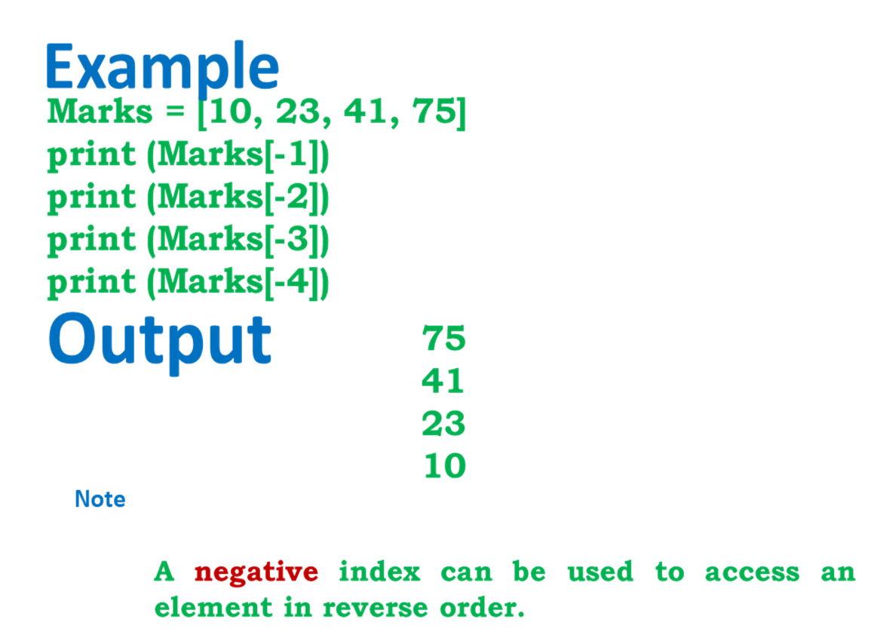

Slide 14
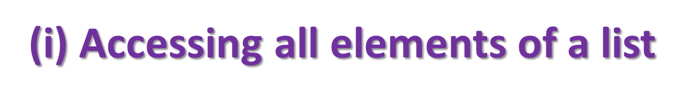
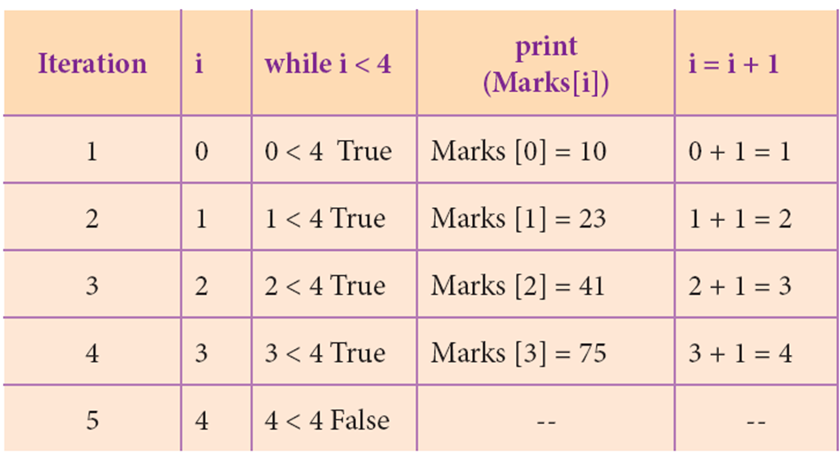
Example
Marks = [10, 23, 41, 75]
i = 0
while i < 4:
print (Marks[i])
i = i + 1
Output
10
23
41
75

Slide 15

Python enables reverse or negative indexing for the list elements.
Thus, python lists index in opposite order.
The python sets -1 as the index value for the last element in list and -2 for the preceding element and so on.
This is called as Reverse Indexing.

Slide 16
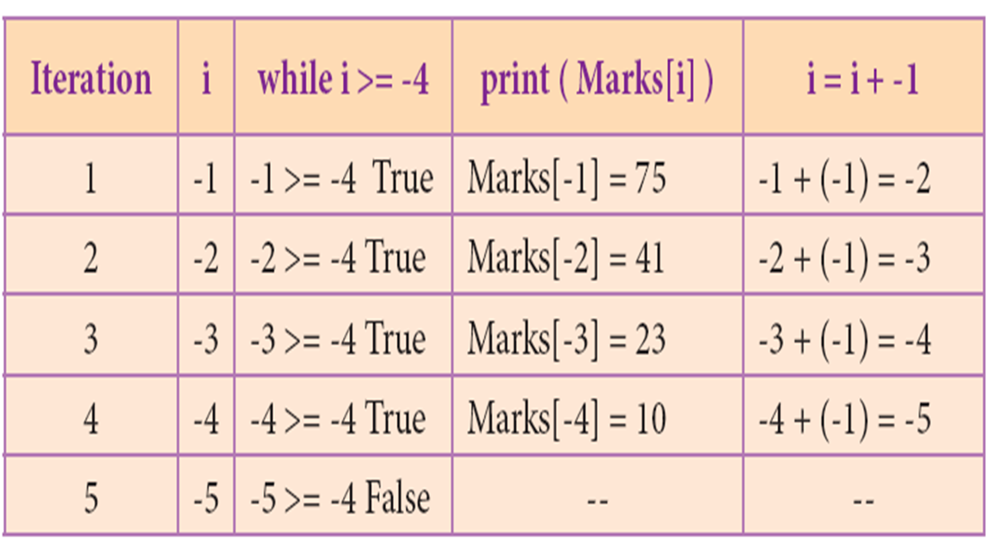
Example
Marks = [10, 23, 41, 75]
i = -1
while i >= -4:
print (Marks[i])
i = i + -1
Output
75
41
23
10

Slide 17
List Length
The len( ) function in Python is used to find the length of a list. (i.e., the number of elements in a list).
Usually, the len( ) function is used to set the upper limit in a loop to read all the elements of a list.
If a list contains another list as an element, len( ) returns that inner list as a single element.

Slide 18
Example
MySubject = ["Tamil", "English", "Comp. Science", "Maths"]
print(len(MySubject))
OUTPUT:
4

Slide 19
Example
mysubject=["tamil","english","computer science","maths"]
print(mysubject,len(mysubject))
Output:
['tamil', 'english', 'computer science', 'maths'] 4

Slide 20
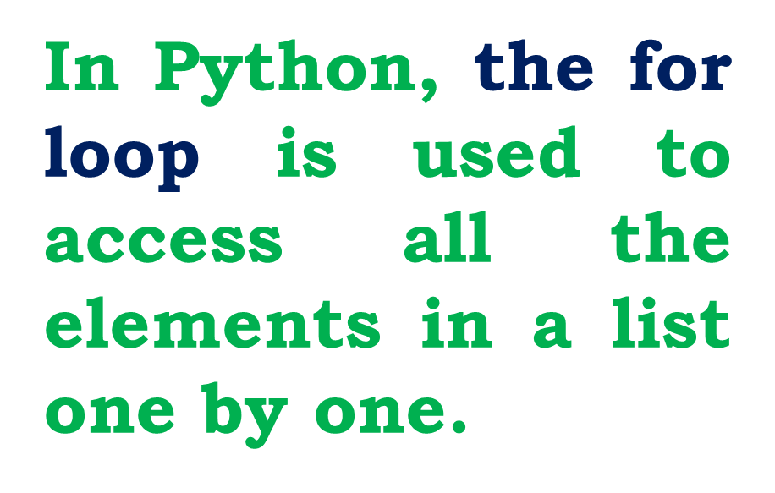
Accessing elements using for loop

Slide 21
Syntax
for index_var in list:
print (index_var)
Here, index_var represents the index value of each element in the list.
Python reads this “for” statement like English:
“For (every) element in (the list of) list and print (the name of the) list items”

Slide 22
Example
Marks=[23, 45, 67, 78, 98]
for x in Marks:
print( x )
Output:
23
45
67
78
98

Slide 23
Changing list elements
In Python, the lists are mutable, which means they can be changed.
A list element or range of elements can be changed or altered by using simple assignment operator (=).

Slide 24
Syntax
List_Variable [index of an element] = Value to be changed
List_Variable [index from : index to] = Values to changed
index from is the beginning index of the range; index to is the upper limit of the range which is excluded in the range.
For example, if you set the range [0:5] means, Python takes only 0 to 4 as element index. Thus, if you want to update the range of elements from 1 to 4, it should be specified as [1:5].

Slide 27
Adding more elements in a list
In Python,
append( ) function is used to add a single element
extend( ) function is used to add more than one element to an existing list.
Syntax
List.append (element to be added)
List.extend ( [elements to be added])

Slide 28
In extend( ) function, multiple elements should be specified within square bracket as arguments of the function.
Example
Mylist=[34, 45, 48]
Mylist.append(90)
print(Mylist)
Output:
[34, 45, 48, 90]

Slide 29
Example
Mylist=[34, 45, 48]
Mylist.append(90)
print(Mylist)
Output:
[34, 45, 48, 90]
Example
Mylist=[34, 45, 48]
Mylist.extend([66,77,788,999])
Mylist.extend([43,65,87,98,434,32])
print(Mylist)
Output:
[34, 45, 48, 66, 77, 788, 999, 43, 65, 87, 98, 434, 32]

Slide 30
Inserting elements in a list
append( ) function in Python is used to add more elements in a list. But, it includes elements at the end of a list.
If you want to include an element at your desired position, you can use insert ( ) function. The insert( ) function is used to insert an element at any position of a list.

Slide 31

Syntax
index - position where an element needs to be inserted
element - this is the element to be inserted in the list

Slide 32
example
>>> MyList=[34,98,47,'Kannan', 'Gowrisankar', 'Lenin', 'Sreenivasan' ]
>>> print(MyList)
[34, 98, 47, 'Kannan', 'Gowrisankar', 'Lenin', 'Sreenivasan']
>>> MyList.insert(3, 'Ramakrishnan')
>>> print(MyList)
[34, 98, 47, 'Ramakrishnan', 'Kannan', 'Gowrisankar', 'Lenin', 'Sreenivasan']

Slide 33
Deleting elements from a list
There are two ways to delete an element from a list viz.
del statement and remove( ) function.
del statement is used to delete known elements
remove( ) function is used to delete elements of a list if its index is unknown.
The del statement can also be used to delete entire list.

Slide 34
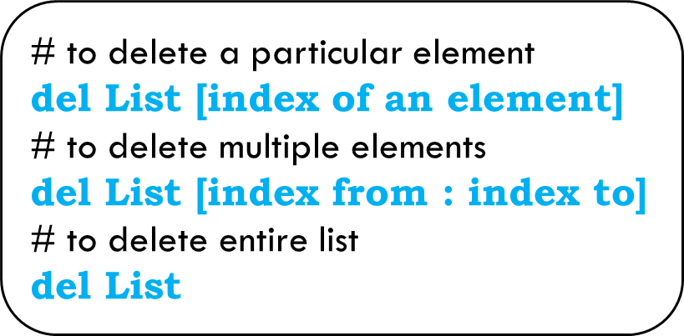
There are two ways to delete an element from a list viz.
del statement and remove( ) function.
del statement is used to delete known elements
remove( ) function is used to delete elements of a list if its index is unknown.
The del statement can also be used to delete entire list.
Syntax

Slide 35
Example
MySubjects = ['Tamil', 'Hindi', 'Telugu', 'Maths']
print (MySubjects)
Output:
['Tamil', 'Hindi', 'Telugu', 'Maths']
MySubjects = ['Tamil', 'Telugu', 'Maths’]
del Mysubjects [1:3]
print (MySubjects)
Output:
['Tamil']

Slide 36
0 | 1 | 2
Tamil | Telugu | Maths
del MySubjects[1:3]
Tamil

Slide 37
>>> del MySubjects,
>>> print (Mysubjects)
deletes the list MySubjects entirely.
When you try to print the elements, Python shows an error as the list is not defined.
Which means, the list MySubjects has been completely deleted.

Slide 38
The remove( ) function can also be used to delete one or more elements if the index value is not known.
Apart from remove( ) function, pop( ) function can also be used to delete an element using the given index value.
Example
MyList=[12,89,34,'Kannan', 'Gowrisankar', 'Lenin']
print(MyList)
MyList.remove(89)
print(MyList)
OUTPUT:
[12, 89, 34, 'Kannan', 'Gowrisankar', 'Lenin']
[12, 34, 'Kannan', 'Gowrisankar', 'Lenin']

Slide 39
The function clear( ) is used to delete all the elements in list, it deletes only the elements and retains the list. Remember that, the del statement deletes entire list.
clear( ) function removes only the elements and retains the list. Whenyou try to print the list which is already cleared, an empty square bracket is displayed without any elements, which means the list is empty.
Python List pop()
The pop() method removes the item at the given index from the list.
The method also returns the removed item.

Slide 40
Syntax
List.remove(element) # to delete a particular element
List.pop(index of an element)
List.clear( )

Slide 41
Example
>>>MyList=[12,89,34,'Kannan', 'Gowrisankar', 'Lenin']
>>> MyList.pop(1)
89
>>> print(MyList)
[12, 34, 'Kannan', 'Gowrisankar', 'Lenin']
>>> MyList.clear( )
>>> print(MyList)
[ ]

Slide 42
List and range ( ) function
The range( ) is a function used to generate a series of values in Python.
Using range( ) function, you can create list with series of values.
The range( ) function has three arguments.

Slide 43
Syntax
range (start value, end value, step value)
start value – beginning value of series. Zero is the default beginning value.
end value – upper limit of series. Python takes the ending value as upper limit – 1.
step value – It is an optional argument, which is used to generate different interval of values.

Slide 44
Example
Example
for x in range (1, 11):
print(x)
for x in range (2,11,2):
print(x)
Output:
1
2
3
4
5
6
7
8
9
10
Output:
2
4
6
8
10

Slide 45
Creating a list with series of values
Using the range( ) function, you can create a list with series of values.
To convert the result of range( ) function into list, we need one more function called
list( ).
The list( ) function makes the result of range( ) as a list. The list ( ) function is all so used to create list in python.

Slide 46
Syntax
List_Variable = list ( range ( ) )

Slide 47

List comprehensions
List comprehension is a simplest way of creating sequence of elements that satisfy a certain condition.
Syntax
List = [ expression for variable in range ]
Example
squares = [ x ** 2 for x in range(1,11) ]
print (squares)
Output:
[1, 4, 9, 16, 25, 36, 49, 64, 81, 100]

Slide 48
Other important list funcion
Syntax
copy ( )
List.copy()
Returns a copy of the list
Example
MyList=[12, 12, 36]
x = MyList.copy()
y = MyList.copy()
print(x)
print(y)
Output
[12, 12, 36]
[12, 12, 36]

Slide 49
Syntax
count ( )
List.count(value)
Returns the number of similar elements present in the list.
Example
vowels = ['a', 'e', 'i', 'o', 'i', 'u']
count = vowels.count('i')
print('The count of i is:', count)
count = vowels.count('p')
print('The count of p is:', count)
Output
The count of i is: 2
The count of p is: 0

Slide 50
Syntax
index( )
List.index(element)
Returns the index value of the first recurring element.
The index() method searches an element in the list and returns its index.

Slide 51
Example
MyList=[36 ,22 ,12]
x = MyList.index(12)
print(x)
Output
2

Slide 52
Syntax
reverse( )
List.reverse()
Reverses the order of the element in the list.
Example
Output
MyList=[36 ,22 ,12]
MyList.reverse()
print(MyList)
[12, 22, 36]

Slide 53
Syntax
sort( )
List.sort(reverse=True|False, key=myFunc)
Sorts the element in list
MyList=['Thilothamma', 'Tharani', 'Anitha','SaiSree','Lavanya']
MyList.sort( )
print(MyList)
MyList.sort(reverse=True)
print(MyList)
Output:
['Anitha', 'Lavanya', 'SaiSree', 'Tharani', 'Thilothamma']
['Thilothamma', 'Tharani', 'SaiSree', 'Lavanya', 'Anitha']

Slide 54

Syntax
max( )
max(list)
Returns the maximum value in a list.
Output
MyList=[21,76,98,23]
print(max(MyList))
98

Slide 55

Syntax
min( )
min(list)
Returns the minimum value in a list.
Output
MyList=[21,76,98,23]
print(min(MyList))
21

Slide 56
Syntax
sum( )
sum(list)
Returns the sum of value in a list.
Output
218
MyList=[21,76,98,23]
print(sum(MyList))

Slide 57
Tuples

Slide 58
Introduction to Tuples
Tuples consists of a number of values separated by comma and enclosed within parentheses.
Tuple is similar to list, values in a list can be changed but not in a tuple.

Slide 59
Advantages of Tuples over list
1. The elements of a list are changeable (mutable) whereas the elements of a tuple are unchangeable (immutable), this is the key difference between tuples and list.
2. The elements of a list are enclosed within square brackets. But, the elements of a tuple are enclosed by paranthesis.
3. Iterating tuples is faster than list.

Slide 60
Creating Tuples
Creating tuples is similar to list. In a list, elements are defined within square brackets, whereas in tuples, they may be enclosed by parenthesis.
The elements of a tuple can be even defined without parenthesis.
Whether the elements defined within parenthesis or without parenthesis, there is no differente in it's function.

Slide 61
Syntax
# Empty tuple
Tuple_Name = ( )
# Tuple with n number elements
Tuple_Name = (E1, E2, E2 ……. En)
# Elements of a tuple without parenthesis
Tuple_Name = E1, E2, E3 ….. En

Slide 62
Example
MyTup1 = (23, 56, 89, 'A', 'E', 'I', "Tamil")
print(MyTup1)
MyTup2 = 23, 56, 89, 'A', 'E', 'I', "Tamil"
print (MyTup2)
Output
(23, 56, 89, 'A', 'E', 'I', 'Tamil')
(23, 56, 89, 'A', 'E', 'I', 'Tamil')

Slide 63
Creating tuples using tuple( ) function
The tuple( ) function is used to create Tuples from a list.
When you create a tuple, from a list, the elements should be enclosed within square brackets.

Slide 64
Syntax
Tuple_Name = tuple( [list elements] )
Note
Type ( ) function is used to know the data type of a python object.

Slide 65
Example
MyTup3 = tuple( [23, 45, 90] )
print(MyTup3)
Output
(23, 45, 90)

Slide 66
Creating Single element tuple
While creating a tuple with a single element, add a comma at the end of the element.
In the absence of a comma, Python will consider the element as an ordinary data type; not a tuple. Creating a Tuple with one element is called “Singleton” tuple.

Slide 67
Example
>>> MyTup4 = (10)
>>> type(MyTup4)
Output
<class ‘int'>

Slide 68
Example
>>> MyTup4 = (10,)
>>> type(MyTup4)
Output
<class ‘tuple'>

Slide 69
Accessing values in a Tuple
Like list, each element of tuple has an index number starting from zero.
The elements of
a tuple can be easily accessed by using index number.

Slide 70
Example
thistuple = ("apple", "banana", "cherry")
print(thistuple[1])
OUTPUT:
banana

Slide 71
Example
Tup1 = (12, 78, 91, "Tamil", "Telugu", 3.14, 69.48)
print(Tup1)
#accessing selected elements using indices
print(Tup1[2:5])
print(Tup1[:5])
print(Tup1[4:])
print(Tup1[:])
Output (12, 78, 91, 'Tamil', 'Telugu', 3.14, 69.48)
          (91, 'Tamil', 'Telugu')
          (12, 78, 91, 'Tamil', 'Telugu')
          ('Telugu', 3.14, 69.48)
          (12, 78, 91, 'Tamil', 'Telugu', 3.14, 69.48)

Slide 72
0 | 1 | 2 | 3 | 4 | 5 | 6
12 | 78 | 91 | Tamil | Telugu | 3.14 | 69.48

Slide 73
Update and Delete Tuple
A tuple is immutable, the elements in a tuple cannot be changed. Instead of altering values in a tuple, joining two tuples or deleting the entire tuple is possible.

Slide 74
A tuple is immutable, the elements in a tuple cannot be changed. Instead of altering values in a tuple, joining two tuples or deleting the entire tuple is possible.

Slide 75
Example
Tup1 = (2,4,6,8,10)
Tup2 = (1,3,5,7,9)
Tup3 = Tup1 + Tup2
print(Tup3)
Output
(2, 4, 6, 8, 10, 1, 3, 5, 7, 9)

Slide 76
Syntax:
del tuple_name
Output:
Traceback (most recent call last):
File "D:\shyamaladevipython\tuple.py", line 39, in <module>
print(Tup3)
NameError: name 'Tup3' is not defined. Did you mean: 'Tup1'?
Example
Tup1 = (2,4,6,8,10)
Tup2 = (1,3,5,7,9)
Tup3 = Tup1 + Tup2
del(Tup3)
print(Tup3)

Slide 77
Tuple Assignment
Tuple assignment is a powerful feature in Python.
It allows a tuple variable on the left of the assignment operator to be assigned to the values on the right side of the assignment
operator.
Each value is assigned to its respective variable.

Slide 78
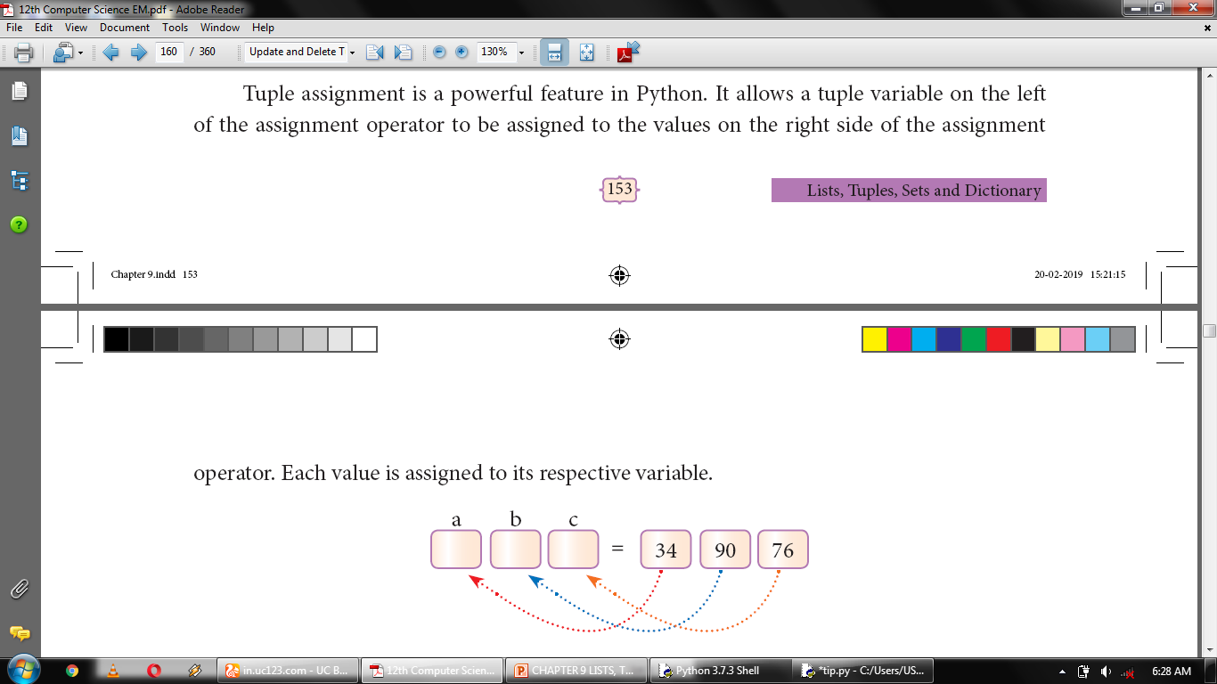

Slide 79
Example
(a,b,c,d)=(1,2,3,4)
e=a+b+c+d
print (e)
OUTPUT:
10

Slide 80
Returning multiple values in Tuples
A function can return only one value at a time, but Python returns more than one value from a function. Python groups multiple values and returns them together.

Slide 81
Example
def Min_Max(n):
a = max(n)
b = min(n)
return(a, b)
Num = (12, 65, 84, 1, 18, 85, 99)
(Max_Num, Min_Num) = Min_Max(Num)
print("Maximum value = ", Max_Num)
print("Minimum value = ", Min_Num)
OUTPUT:
Maximum value = 99
Minimum value = 1

Slide 82
Nested Tuples
In Python, a tuple can be defined inside another tuple; called Nested tuple. In a nested tuple, each tuple is considered as an element.
The for loop will be useful to access all the elements in a nested tuple.

Slide 83
Example
Mylist = ((3.4,.76,65,786),(4,6,7),(65,65,43,4))
a=len(Mylist)
print(Mylist,a)
OUTPUT:
((3.4, 0.76, 65, 786), (4, 6, 7), (65, 65, 43, 4)) 3
Mylist = ((3.4,.76,65,786),(4,6,7),(65,65,43,4))
for i in Mylist:
print(i)
OUTPUT:
(3.4, 0.76, 65, 786)
(4, 6, 7)
(65, 65, 43, 4)

Slide 84
Sets
A set is another type of collection data type.
A Set is a mutable and an unordered collection of elements without duplicates.
That means the elements within a set cannot be repeated.
This feature used to include membership testing and eliminating duplicate elements.

Slide 85
syntax
Set_Variable = {E1, E2, E3 …….. En}

Slide 86
Creating a Set
A set is created by placing all the elements separated by comma within a pair of curly brackets{ }.
The set( ) function can also used to create sets in Python.

Slide 88
Creating Set using List or Tuple
A list or Tuple can be converted as set by using
set( ) function.
First you have to create a list or Tuple then, substitute its variable within set( ) function as argument.

Slide 89
Example
MyList=[2,4,6,8,10]
MySet=set(MyList)
print(MySet)
OUTPUT:
{2, 4, 6, 8, 10}

Slide 90
Set Operations
The python is also supports the set operations such as
Union
Intersection
Difference
Symmetric difference

Slide 91
| union
& intersection
– difference
^ symmetric difference

Slide 92
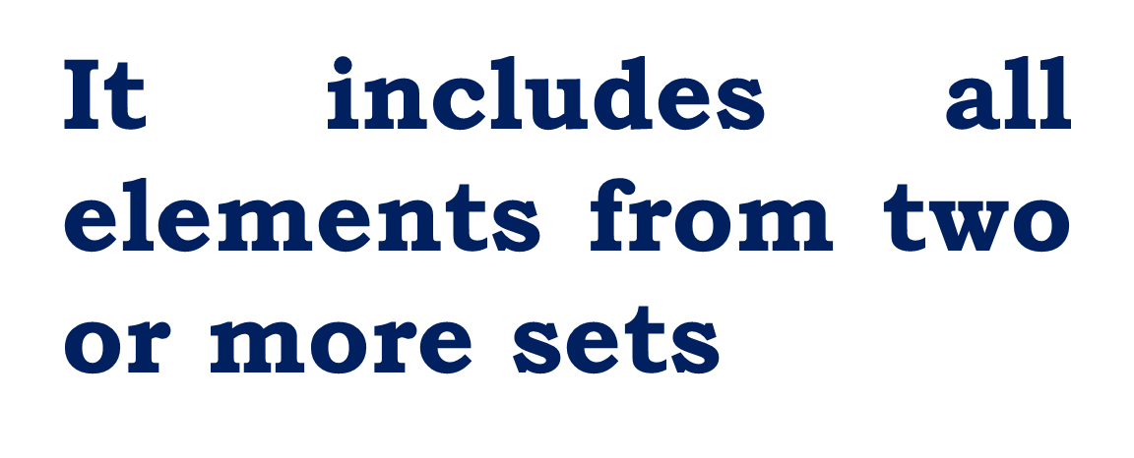
Union

Slide 93
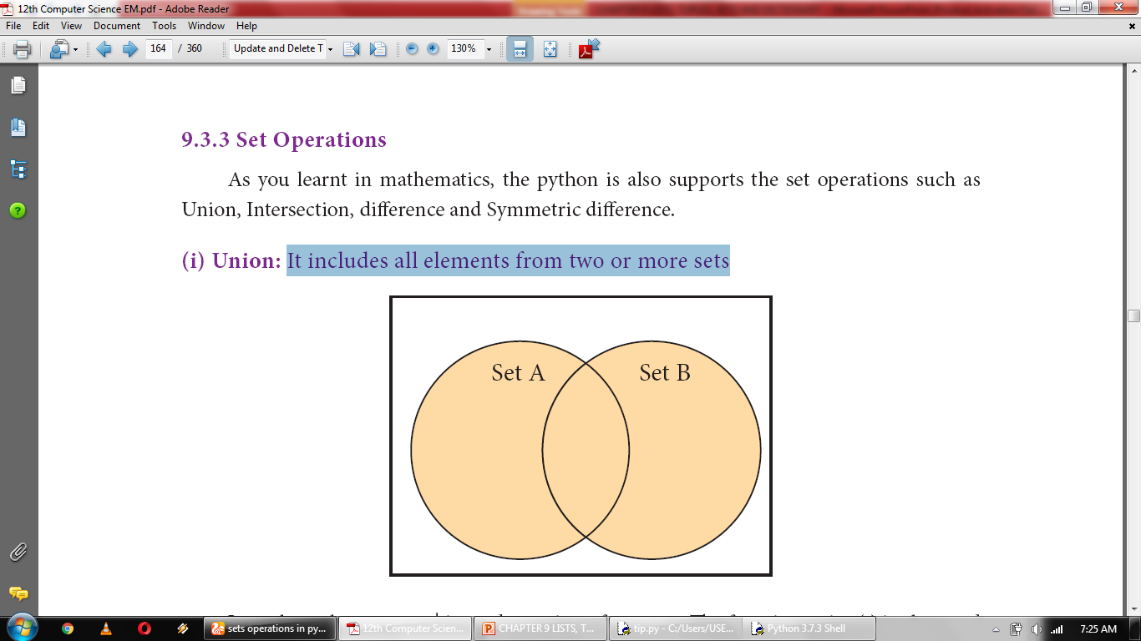
In python, the operator | is used to union of two sets. The function union( ) is also used to join two sets in python.

Slide 94
Example
Example
A = {0, 2, 4, 6, 8};
B = {1, 2, 3, 4, 5};
print("Union :", A | B)
set_A={2,4,6,8}
set_B={'A', 'B', 'C', 'D'}
set_U=set_A.union(set_B)
print(set_U)
OUTPUT:
Union : {0, 1, 2, 3, 4, 5, 6, 8}
OUTPUT:
{'C', 2, 4, 6, 8, 'D', 'B', 'A'}

Slide 95
Example
set_A={2,4,6,8}
set_B={'A', 'B', 'C', 'D'}
set_U=set_A.union(set_B)
print(set_U)
OUTPUT:
{2, 4, 6, 'D', 8, 'B', 'A', 'C'}

Slide 96
Intersection
It includes the common elements in two sets

Slide 97
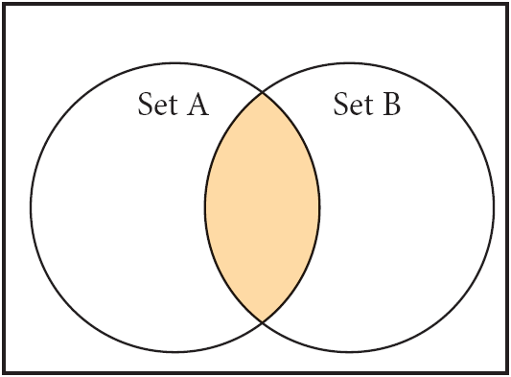

Slide 98
Example
set_A={2,4,6,8}
set_B={'A', 'B', 'C', 'D‘,2}
U_set=set_A & set_B
print(U_set)
OUTPUT:
{2}

Slide 99
Example
set_A={2,4,6,8}
set_B={'A', 'B', 'C', 'D‘,4}
set_U=set_A.intersection(set_B)
print(set_U)
OUTPUT:
{4}

Slide 100
Difference
It includes all elements that are in first set (say set A) but not in the second set (say set B)
The minus (-) operator is used to difference set operation in python.

Slide 101
Example
set_A={2,4,6,8}
set_B={'A', 'B', 'C', 'D',2}
U_set=set_A - set_B
print(U_set)
OUTPUT:
{8,4,6}

Slide 102
Example
set_A={2,4,6,8}
set_B={'A', 'B', 'C', 'D',4}
set_U=set_A.difference(set_B)
print(set_U)
OUTPUT:
{8,2,6}

Slide 103
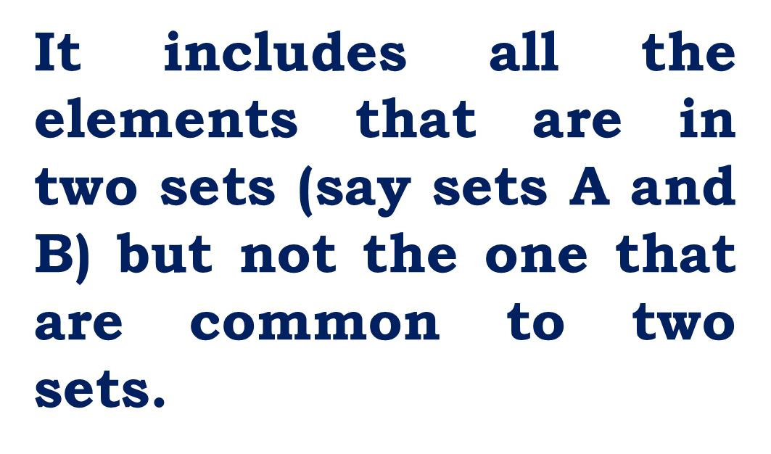
Symmetric difference

Slide 104
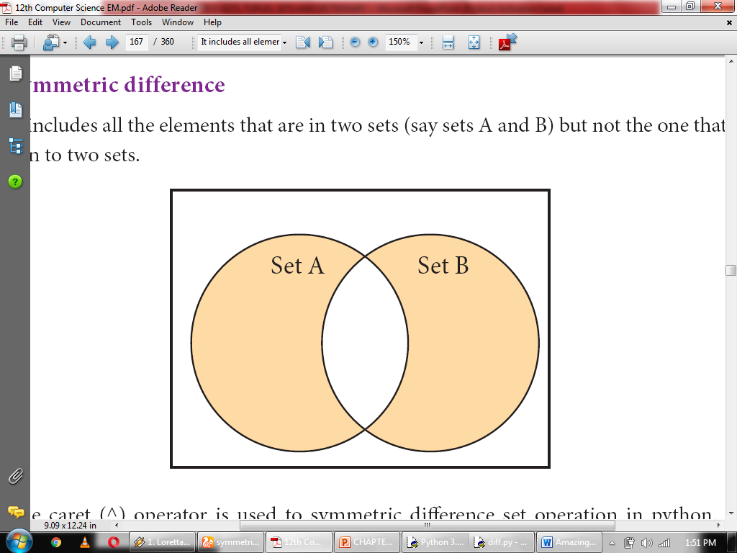
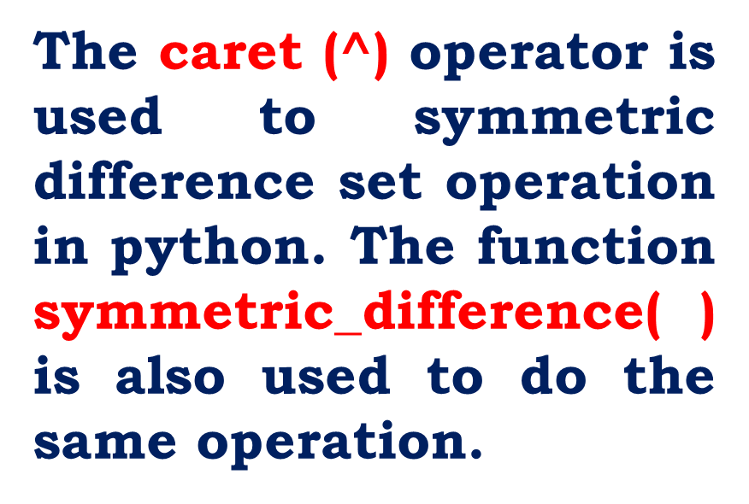

Slide 105
Example
set_A={‘A’,2,4,6,8}
set_B={'A', 'B', 'C', 'D',2}
U_set=set_A^set_B
print(U_set)
OUTPUT:
{4, 6, 8, 'C', 'D', 'B'}

Slide 106
Example
set_A={‘A’,2,4,6,8}
set_B={'A', 'B', 'C', 'D',4}
set_U=set_A.symmetric_difference(set_B)
print(set_U)
OUTPUT:
{'D', 2, 6, 'C', 'B', 8}

Slide 107
A = {0, 2, 4, 6, 8};
B = {1, 2, 3, 4, 5};
# union
print("Union :", A | B)
# intersection
print("Intersection :", A & B)
# difference
print("Difference :", A - B)
# symmetric difference
print("Symmetric difference :", A ^ B)

Slide 108
Dictionaries
A dictionary is a mixed collection of elements.
The dictionary type stores a key along with its element.
The keys in a Python dictionary is separated by a colon ( : ) while the commas work as a separator for the elements.
The key value pairs are enclosed with curly braces { }.

Slide 109
Syntax
Dictionary_Name = {
Key_1: Value_1, Key_2:Value_2,
……..
Key_n:Value_n
}
Key in the dictionary must be unique case sensitive and can be of any valid Python type.

Slide 110
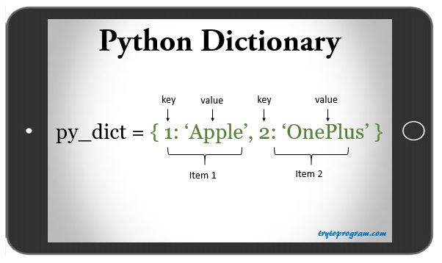
EXAMPLE
myDict = {1:"Apple", 2:"OnePlus"}
print(myDict)
OUTPUT:
{1: 'Apple', 2: 'OnePlus'}

Slide 111
Creating a Dictionary

Slide 112
Example
myDict = {"A":"Apple", "B":"Boy", "C":"Cat"}
print(myDict)
OUTPUT:
{'A': 'Apple', 'B': 'Boy', 'C': 'Cat'}

Slide 113
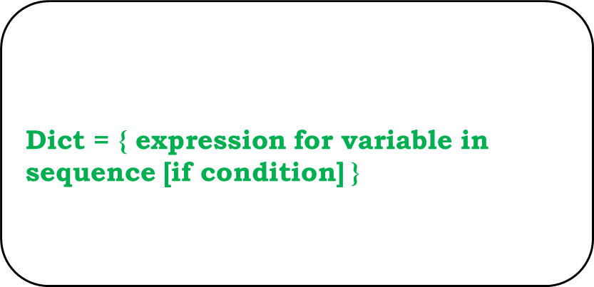
Dictionary Comprehensions
syntax
The if condition is optional and if specified, only those values in the sequence are evaluated using the expression which satisfy the condition.

Slide 114
Example
Dict = { x : 2 * x for x in range(1,10)}
print(Dict)
OUTPUT:
{1: 2, 2: 4, 3: 6, 4: 8, 5: 10, 6: 12, 7: 14, 8: 16, 9: 18}

Slide 115
Accessing, Adding, Modifying and Deleting elements from a Dictionary

Slide 118
Deleting

Slide 120
Hands on Experience

Slide 121


Slide 123
Write a program that prints the maximum value in a Tuple.
tuple1 = (5, 17, 15, 20, 7, 3)
print ("Maximum value", max(tuple1))
OUTPUT:
Maximum value 20

Slide 124
Write a program that finds the sum of all the numbers in a Tuples using while loop.
li = [10,20,30]
s = 0
i = 0
while i < len(li):
s= s + li[i]
i+= 1
print(s)
OUTPUT:
60

Slide 125
Write a program that finds sum of all even numbers in a list.
list = [1, 2, 3, 4, 5, 6, 7, 8, 9, 10]
e = 0
for i in list:
if i%2==0:
e= e + i
print ("Sum of even number", e)
OUTPUT:
Sum of even number 30

Slide 126
Write a program that reverse a list using a loop.
mylist = [1, 2, 3, 4, 5]
mylist.reverse()
print(mylist)
OUTPUT:
[5, 4, 3, 2, 1]
OUTPUT:
75
41
23
10
Marks = [10, 23, 41, 75]
i = -1
while i >= -4:
print (Marks[i])
i=i+-1

Slide 127
Write a program to insert a value in a list at the specified location
list = [1, 2, 4, 5]
list.insert (2, 3)
print (list)
OUTPUT:
[1, 2, 3, 4, 5]

Slide 128
Write a program that creates a list of numbers from 1 to 50 that are either divisible by 3 or divisible by 6.
a = [ ]
for i in range (1, 51):
if i % 3 == 0 or i % 6 == 0:
a.append (i)
print (a)
OUTPUT:
[3, 6, 9, 12, 15, 18, 21, 24, 27, 30, 33, 36, 39, 42, 45, 48]

Slide 129
Write a program to create a list of numbers in the range 1 to 20. Then delete all the numbers from the list that are divisible by 3.
lower=int(input("Enter lower range limit:"))
upper=int(input("Enter upper range limit:"))
n=int(input("Enter the number to be divided by:"))
for i in range(lower,upper+1):
if(i%n==0):
print(i)
OUTPUT:
3
6
9
12
15
18

Slide 130
Write a program that counts the number of times a value appears in the list. Use a loop to do the same.
list = [8, 6, 8, 10, 8, 20, 10, 8, 8]
x = 8
x = list.count (x)
print (x)
OUTPUT:
5

Slide 131
Write a program that prints the maximum and minimum value in a dictionary.
dict = {'a' : 10, 'b' : 20, 'c' : 5}
v = dict . values ()
print ("Maximum = ", max (v))
print ("Minimum = ", min (v))
OUTPUT:
Maximum = 20
Minimum = 5

Slide 132
Thank you

